Slide 1
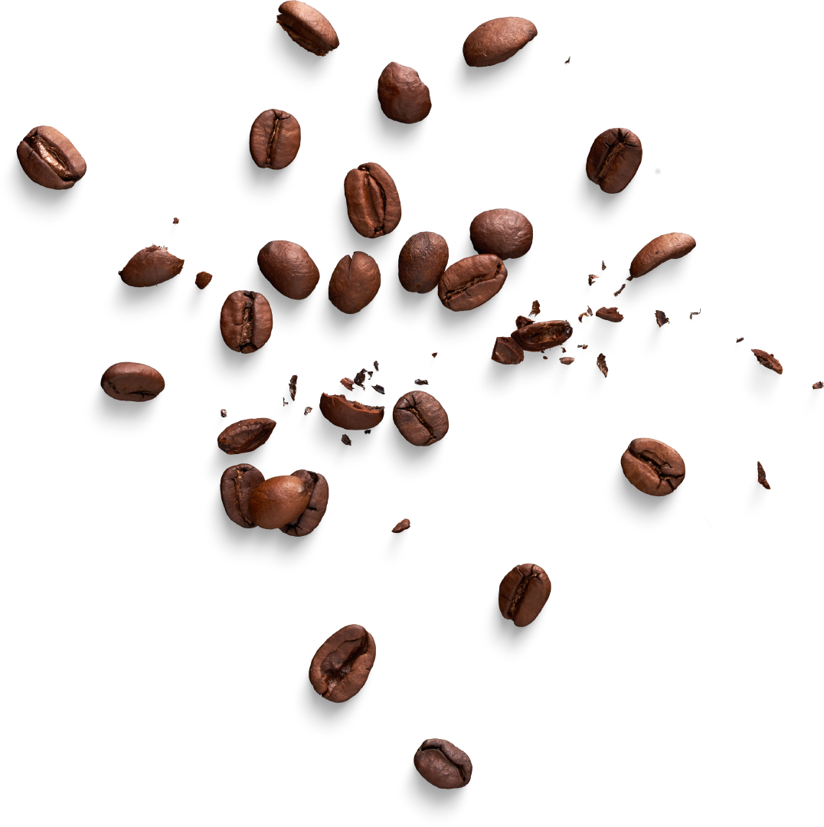


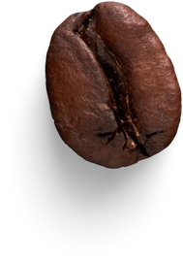
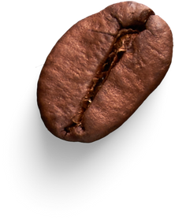
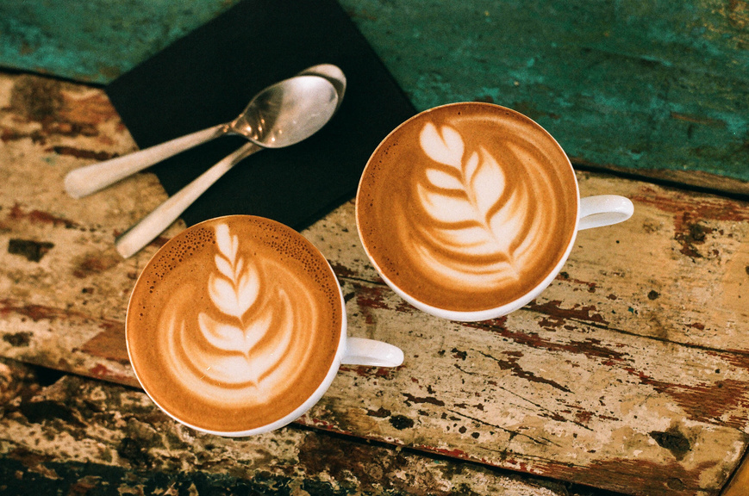
Bright Coffee Shop
BRIGHT COFFEE SHOP
SALES INSIGHTS PRESENTATION
Data-driven insights to support strategic decision-making
LECIA MOCHUENENG
PHUTI.LECIA@GMAIL.COM

Slide 2
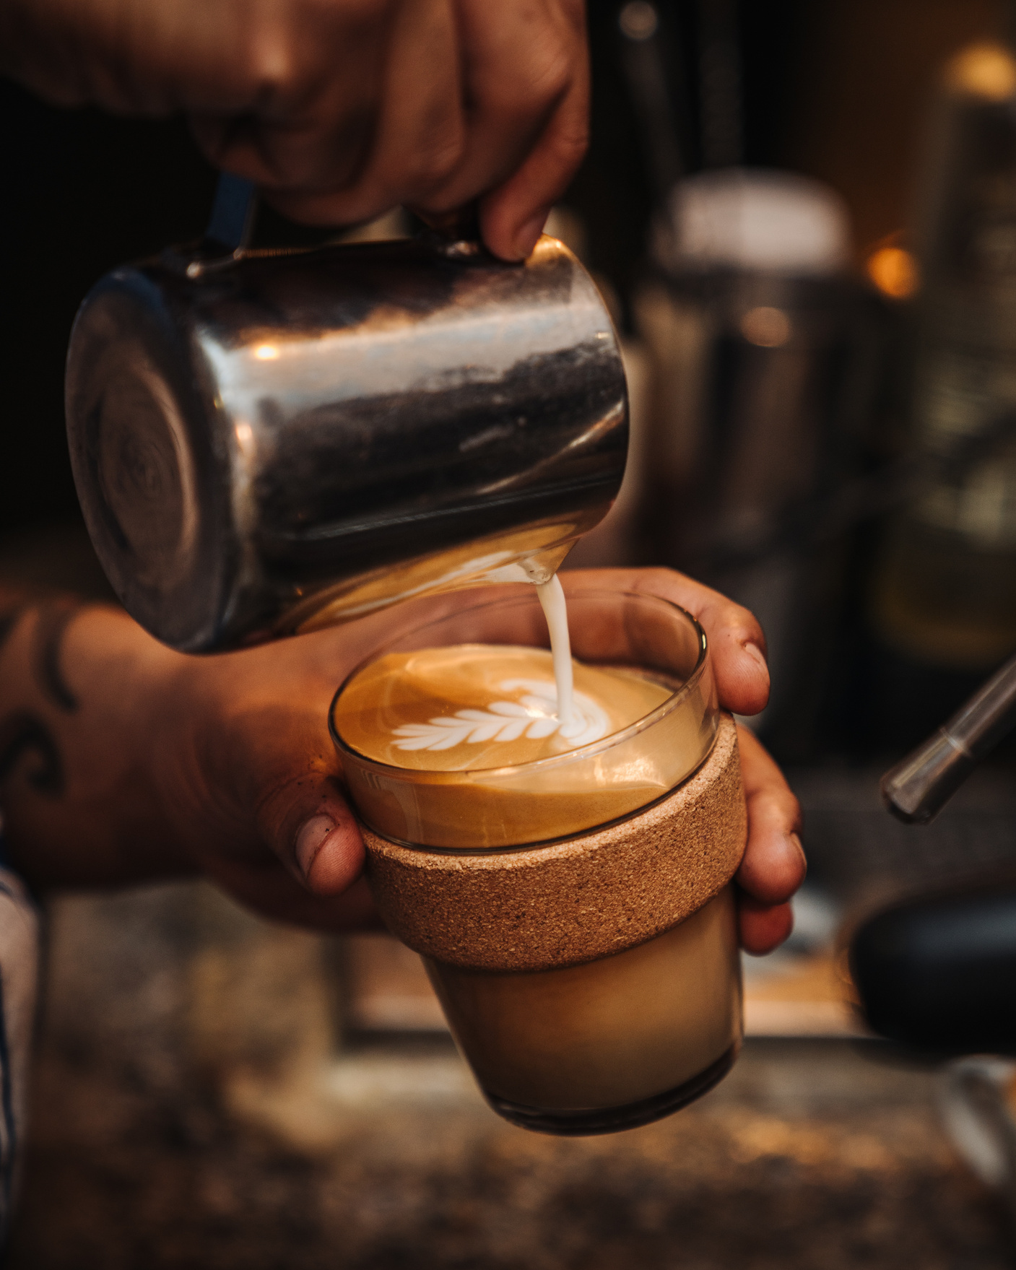

Bright Coffee Shop
Introduction
This presentation provides key insights from a sales data analysis conducted for Bright Coffee Shop.
The objective was to identify top-performing products, understand customer buying behavior across different times of the day, and uncover trends that can inform marketing and operational decisions.
The findings are based on processed transactional data, and are supported by visual dashboards and pivot analysis using Microsoft Excel.

Slide 3
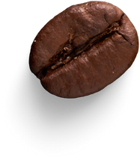
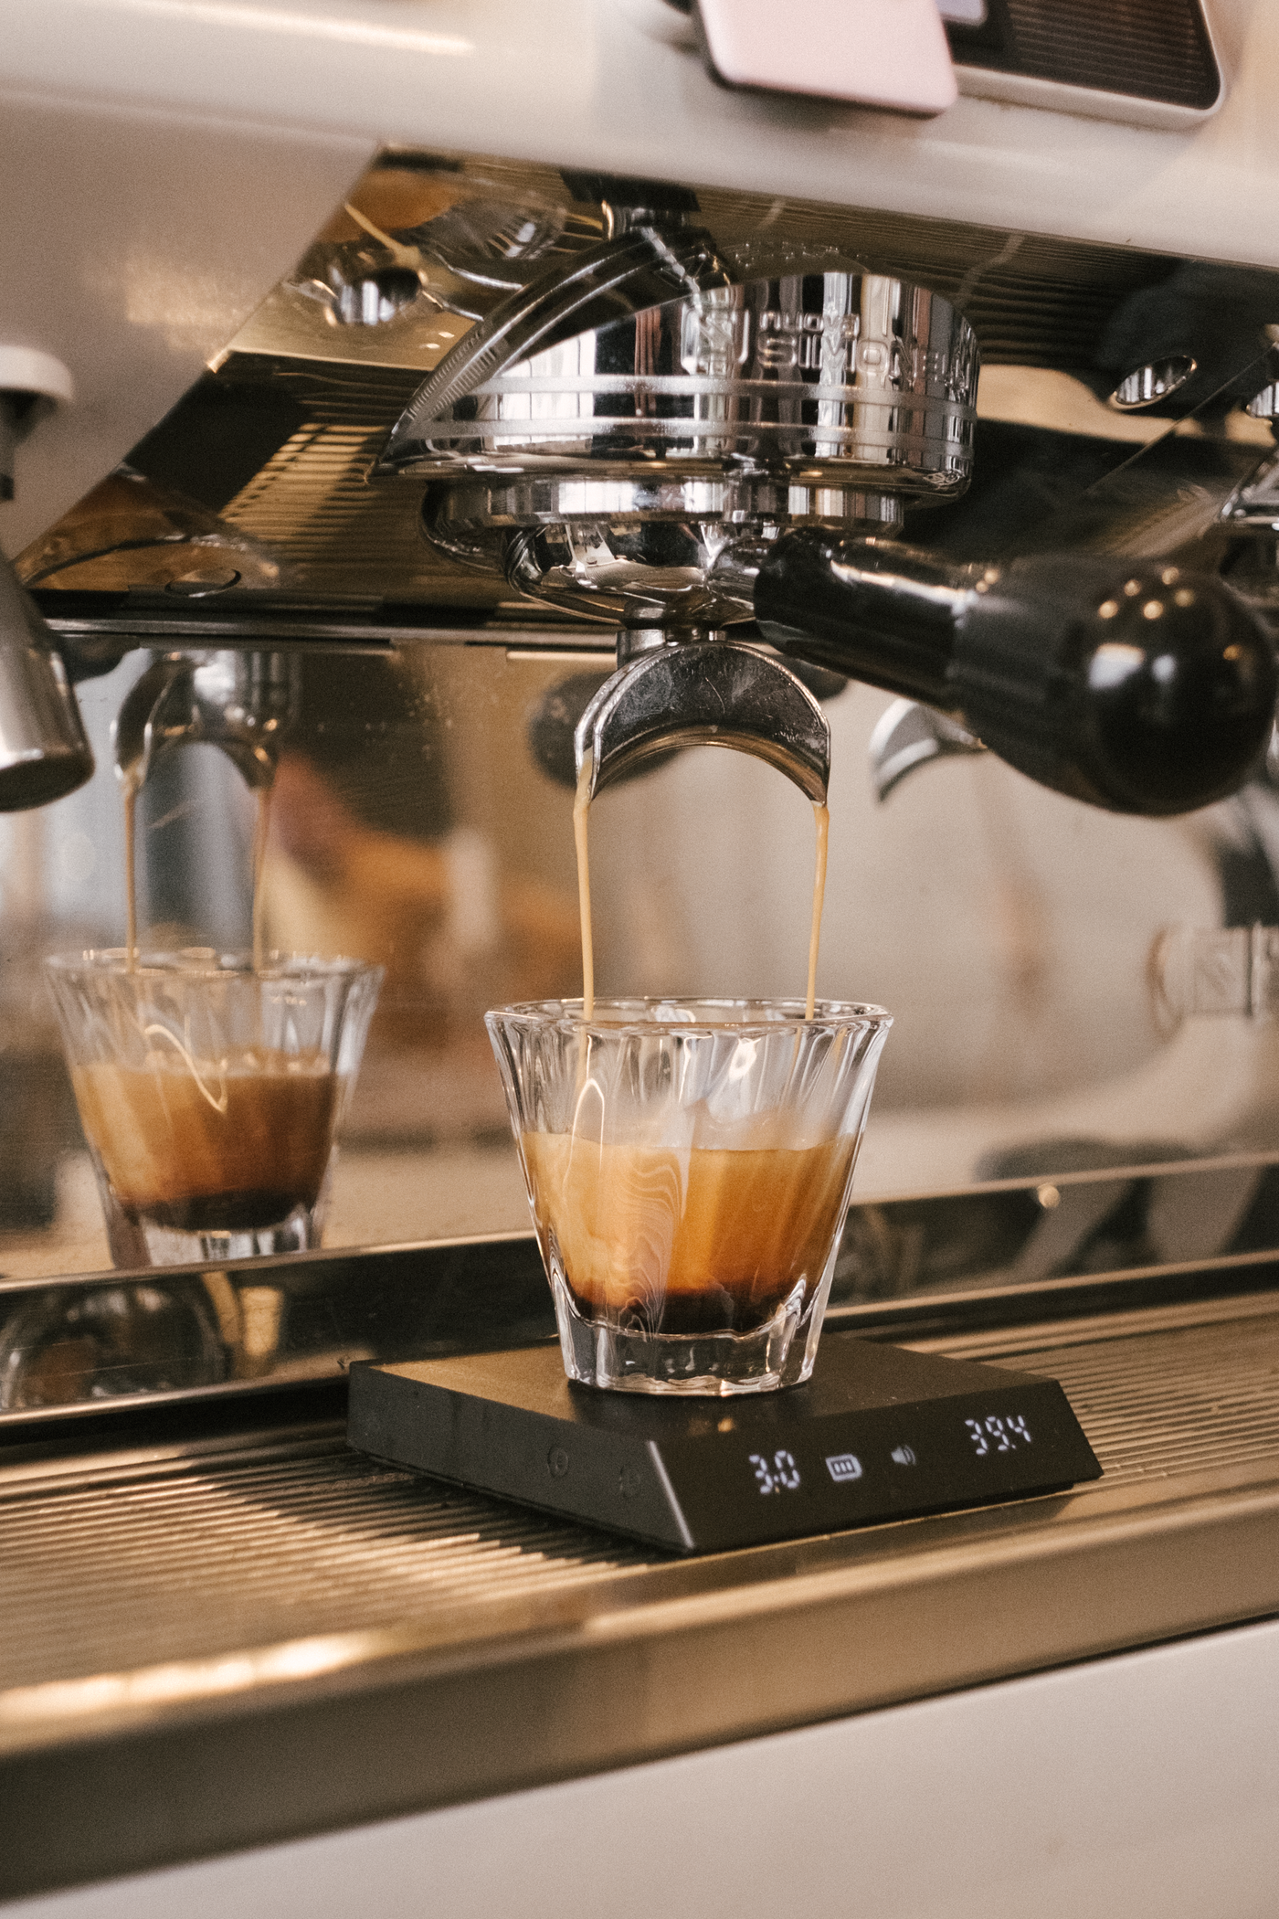

Bright Coffee Shop
What We Set Out to Understand
Which products generate the most revenue?
When does the store perform best?
How do product sales vary throughout the day?
What should we do next?

Slide 4
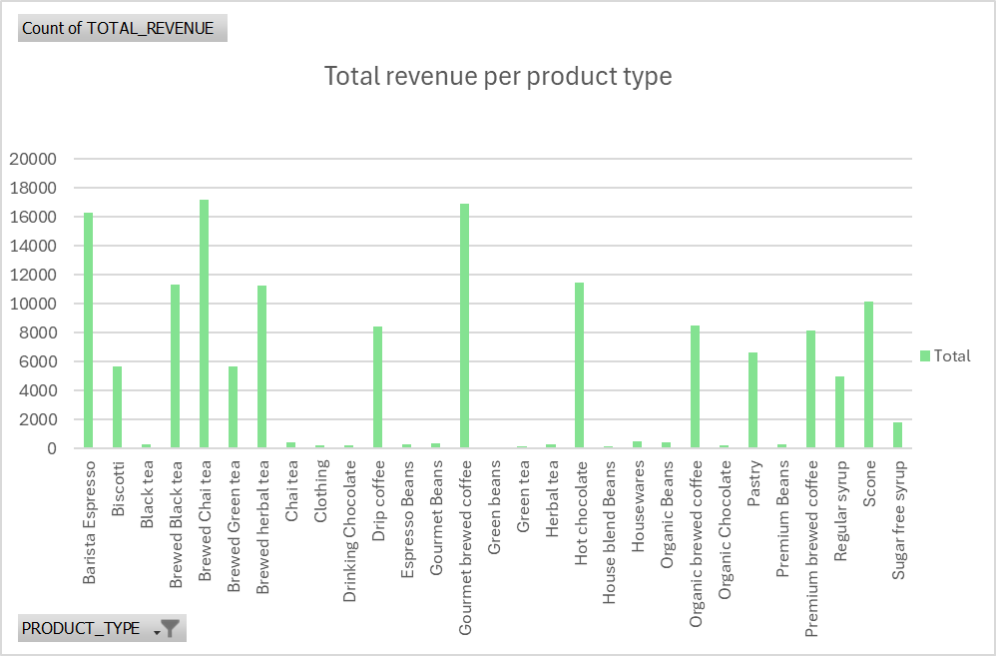
Bright Coffee Shop
Total Revenue by Product Type
Barista Espresso, Brewed Chai Tea, and Gourmet Brewed Coffee are the biggest revenue drivers.
Products like Black Tea, Green Tea, and Herbal Tea generate solid revenue.
Housewares, Clothing, and Sugar Free Syrup contribute the least.
Coffee beans hold steady across categories, showing consistent customer interest.

Slide 5
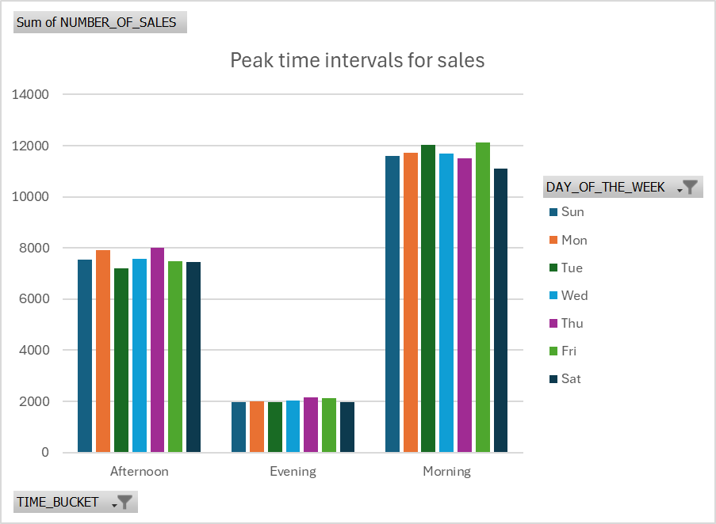
Bright Coffee Shop
When Do Customers Buy the Most?
Sales consistently peak in the mornings throughout the week, making this the most active time for customer purchases. Activity remains steady in the afternoons but sees a noticeable decline by evening.

Slide 6
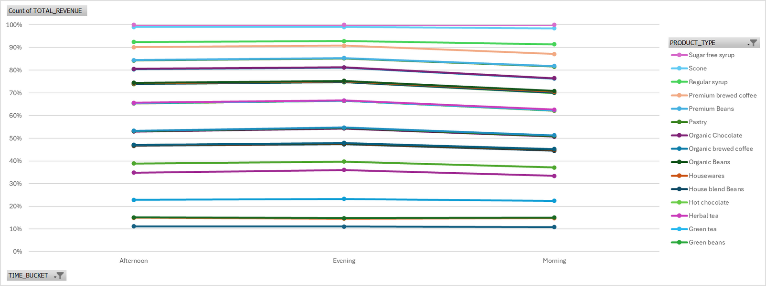
Bright Coffee Shop
Sales Patterns by Time and Product
Most revenue is generated in the morning, driven by high-performing items like Premium Brewed Coffee, Pastries, and Scones, which align with breakfast-time habits. Meanwhile, products such as Green Tea and House Blend Beans maintain steady sales throughout the day.

Slide 7
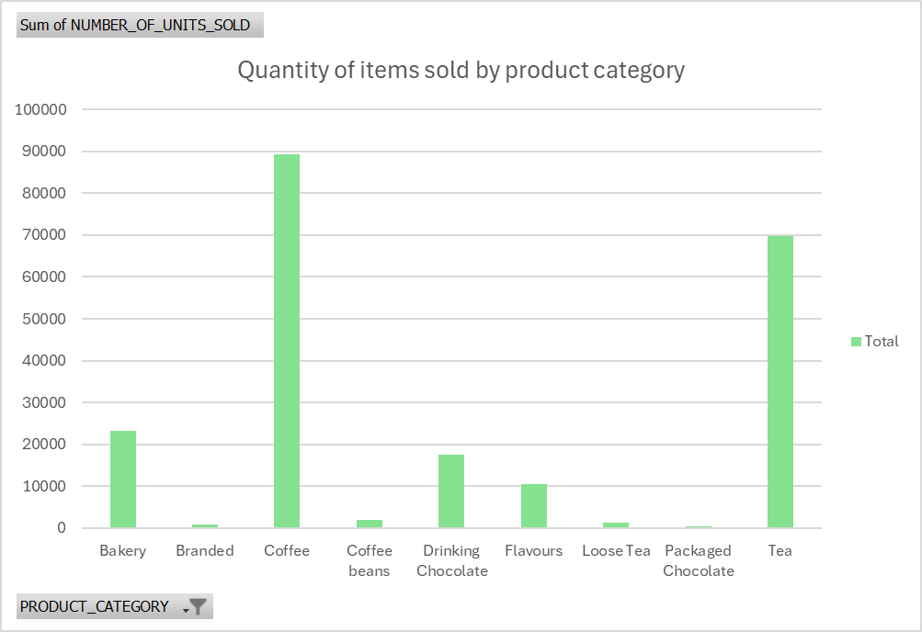
Bright Coffee Shop
What Categories Sell the Most?
The Coffee and Tea categories dominate item sales, with nearly 90,000 and 70,000 units sold respectively, clearly the most popular. Bakery, Drinking Chocolate, and Flavours trail behind as mid-tier performers, while Branded, Coffee Beans, Loose Tea, and Packaged Chocolate show much lower sales volumes under 5,000 units each.

Slide 8
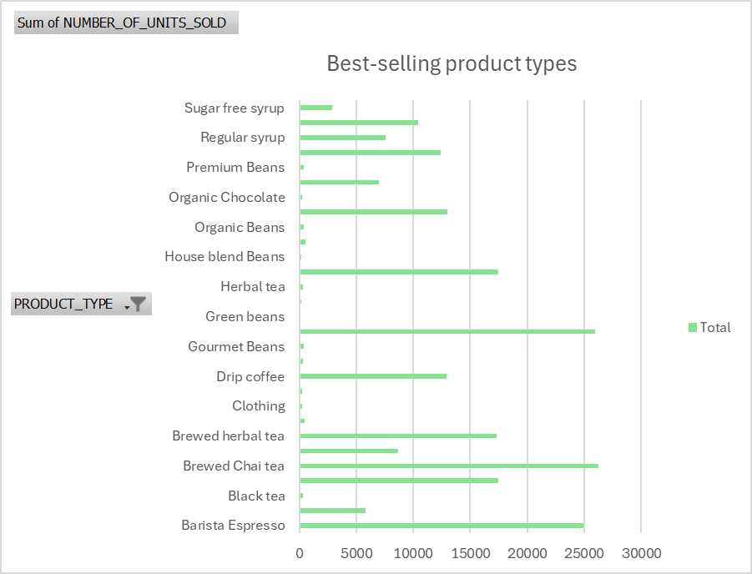
Bright Coffee Shop
What Categories Sell the Most?
Green Beans top the list as the best-selling product category, followed by House Blend Beans and Organic Beans—all showing strong demand for whole coffee bean options.

Slide 9
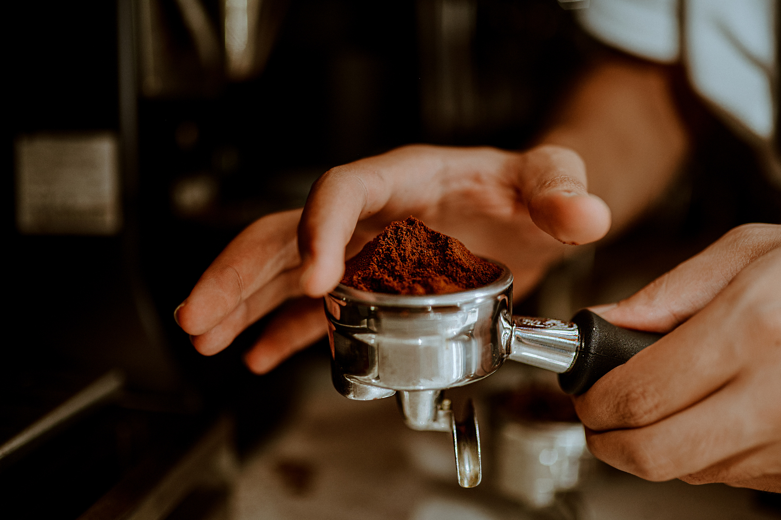

Bright Coffee Shop
Recommendations
Run marketing campaigns during slow periods (e.g., “Afternoon Perks” or “Evening Chill Deals”) to lift non-peak traffic.
Stock and feature bestsellers prominently, especially for morning demand: Espresso, Chai Tea, and Green Beans.
Promote underperforming products creatively, or reevaluate them altogether—especially items with consistently low sales.
Next Step
Automate daily sales reporting for real-time visibility and quicker decision-making.
Begin tracking sales across multiple branches to identify regional performance patterns.
Launch loyalty programs linked to peak times to encourage repeat visits during high-traffic windows.

Slide 10
Bright Coffee Shop
THANK YOU

